Slide 1
SEA Improving Scientific Software
Architecture Agnostic Docker Build Systems
Julio Suarez
April 2019

Slide 2
Outline
General Education.
Application Stack.
Workload Isolation.
Virtual Machines vs. Containers.
Docker Basics.
Docker Best Practices For Multi-Arch.
Motivation.
Examples.
Multi-Arch Registries.

Slide 3
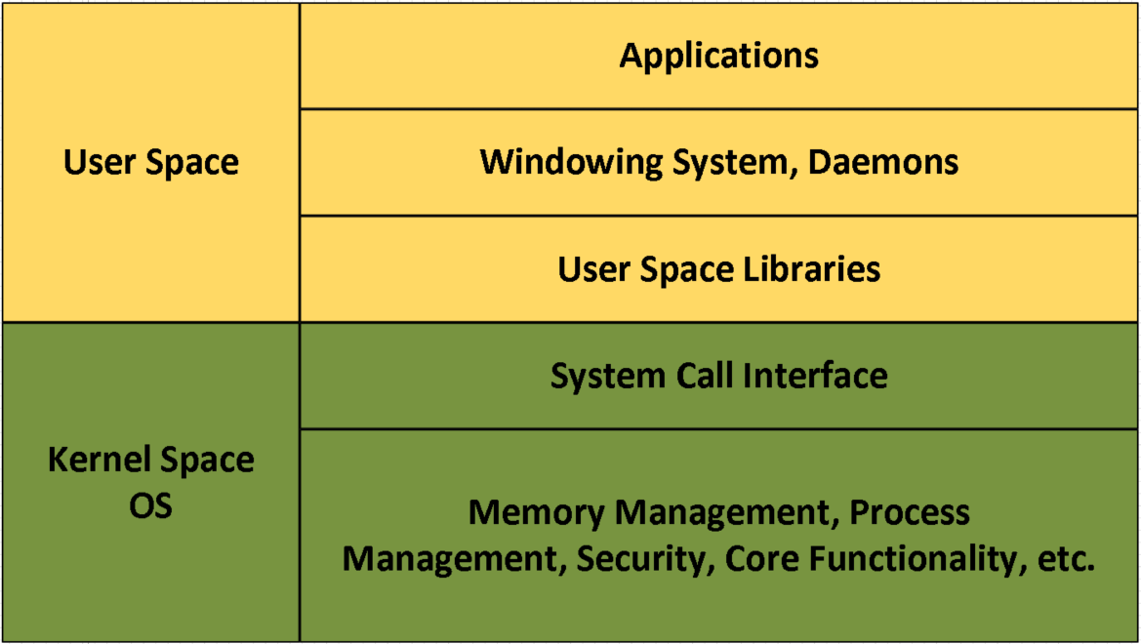
Basic Components of an Application Stack
An App Stack has two main components:
Kernel Space (The OS)
Closest to the HW
Device Drivers
Process Creation/Scheduling
Memory management
Security
User Space
Applications
Background services/daemons
User Space Libraries
Contains wrappers for system calls for making requests to the kernel.

Slide 4
Workload Isolation
Workloads can be just about anything:
Run a simulation.
Run an application.
Play a video game.
Each workload could belong to a different user.
Workloads are isolated to prevent one workload/user from interfering with another workload/user.
Isolated environments can be Virtual Machines (VM) or Containers.
Increases efficiency of HW resources.
Enables cloud computing.

Slide 5
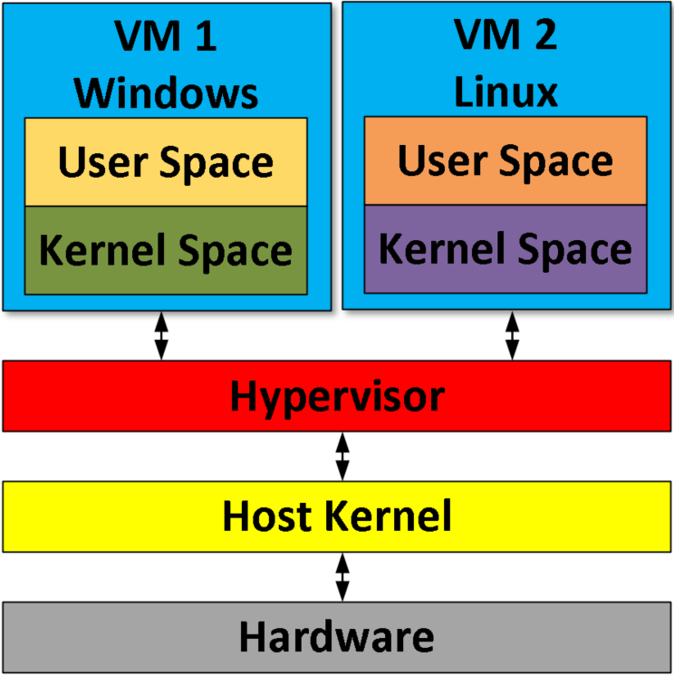
Virtual Machines Vs. Containers

Slide 6
Virtual Machines Vs. Containers
Each VM has a complete application stack.

Slide 7
Virtual Machines Vs. Containers
Each VM can run a different kernel (OS).

Slide 8
Virtual Machines Vs. Containers
Hypervisor handles isolation & security.
Hypervisor emulates platform hardware.

Slide 9
Virtual Machines Vs. Containers
Containers do not have a kernel (OS).
Only a User Space & File System is present.

Slide 10
Virtual Machines Vs. Containers
Containers do not rely on a Hypervisor.

Slide 11
Virtual Machines Vs. Containers
Containers rely on host kernel for isolation & security.
Features like cgroups and namespaces are used.

Slide 12
Virtual Machines Vs. Containers
User Space must be compatible with the host kernel.
Thus, we cannot run a Windows container on a Linux Host or vice versa.

Slide 13
Containers and VMs side by side
Technology | Performance | Impact of a crash/hack | Startup Time | Isolation | Guest OSes | Number of deployments per machine
Containers | Near Native OS Performance* | More likely to take down entire system | Faster (1 – 2 seconds) | Kernel | Must be same as host | More (2x -3x over VMs)
VMs | Hypervisor Overhead | More likely to only take down the VM | Slower (10 – 20 seconds) | Hypervisor | Can be different from host | Fewer
* Network performance can be significantly impacted.

Slide 14
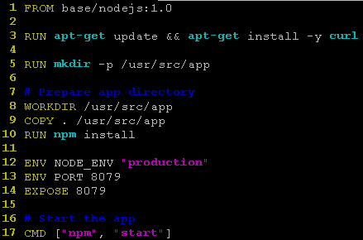
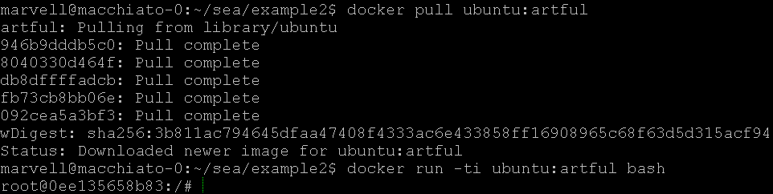
Docker
Docker wraps an app into container images.
Creates rootfs; install app for execution in a container.
Typically you only run a single application in a container.
Docker can run containers.
A container is a runnable instance of an image.
Docker can manage a cluster.
Why has Docker become popular?
Raise of cloud computing.
Docker built an ecosystem:
Easy to use.
Container image registries/repos:
Docker Hub (Public).
Docker Store (Enterprise centric).
Private registries.
Images are referenced by a name and tag.
The tag is usually a version or release name.
<name>:<tag>
Example: ubuntu:bionic, ubuntu:18.10
Note: <tag> defaults to ‘latest’ if it is not indicated.
Example Dockerfile
Example Image Pull & Run

Slide 15
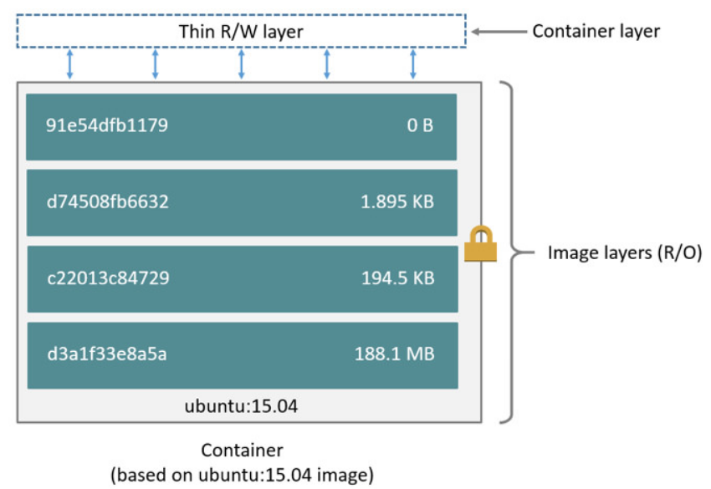
Docker
Composition of a Docker image/container.
Fundamental component is a Union Mount Filesystem.
Docker can use a variety of Union Mount Filesystems, for example:
OverlayFS
AUFS
Union Mount Filesystems combine multiple directories into what appears to be a single virtual directory.
Layers in the container image are created when the FROM, RUN, COPY, or ADD commands are used in a Dockerfile.
https://docs.docker.com/storage/storagedriver/
Creates Layers

Slide 16
Docker
Common commands.
docker build
Builds a docker image based on what is in a Dockerfile.
You can think of a Dockerfile as an container image recipe.
docker pull
Will pull a prebuilt image from a registry.
By default it pulls from DockerHub.
docker push
Will push an image from a local host to a registry.
Can push the a DockerHub personal account.
docker run
Start a container based on an image.
If the image is not present on the local host, a ‘docker pull‘ will run to download the image.
docker save
Packages an existing image into a tarball that can be transferred to another machine.
docker load
Will untar a docker image tarball and make it usable on the host.
Commands documentation.
https://docs.docker.com/engine/reference/commandline/docker/

Slide 17
Outline
General Education.
Application Stack.
Workload Isolation.
Virtual Machines vs. Containers.
Docker Basics.
Docker Best Practices For Multi-Arch.
Motivation.
Examples.
Multi-Arch Registries.

Slide 18
Before We Start
The following scenarios are contrived.
Allows us to illustrate the main points with the fewest commands and lines of code.
To see examples with a real open source project, see the following blog:
https://community.arm.com/tools/b/blog/posts/architecture-agnostic-container-build-systems

Slide 19
What Do We Mean By Architecture Agnostic?
The ability to build and run containers regardless of the underlaying HW architecture.
This is done by being careful with how a container build system is setup.
Why Bother?
Computing is becoming more heterogenous.
Multi-Arch Clouds (e.g. AWS, Packet).
Edge devices come in a variety of architectures.
In this heterogenous env, developers & operators should not have to worry about the HW.
Cloud native app developers should only focus on their app.
Devops engineers should only focus on meeting required service level agreements.
It’s not difficult.
You just have to be a little mindful of what you’re doing.

Slide 20
What Do We Mean By Architecture Agnostic?
Important caveats about architecture agnostic container systems.
In reality, we’re just creating the illusion of an architecture agnostic system.
A single container image is not architecture agnostic.
We just design our container image build system to handle different architectures better/smarter.
An architecture agnostic registry is just a matter of configuration.
We just configure our image registry to handle different architectures better/smarter.
We cannot cross build container images (at least not easily).
Arm container images must be built an on Arm system.
x86 container images must be built on an x86 system.
Ok, so where do we start?
We start with Dockerfiles. They are the fundamental component to creating docker images.
All examples shown are running an on Arm (aarch64) machine (Marvell MacchiatoBin).
https://www.solid-run.com/marvell-armada-family/macchiatobin/

Slide 21
Creating Containers From Dockerfile
Dockerfiles will typically be stored in a repo.
Docker images can be pushed into a registry (like Docker hub), so that the images don’t have to be built every time.

Slide 22
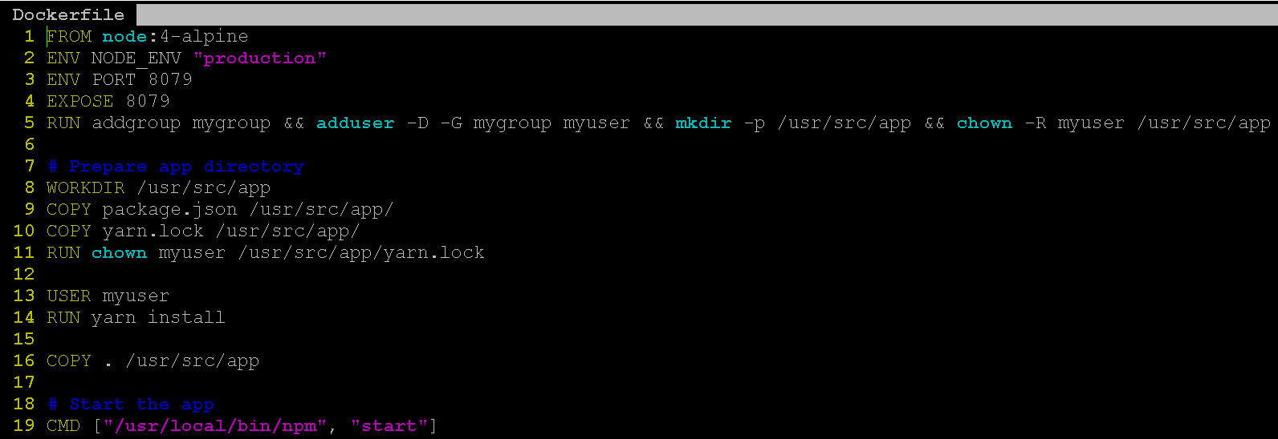
Dockerfiles
Dockerfile Reference:
https://docs.docker.com/engine/reference/builder/

Slide 23
Dockerfiles
Base Image
Dockerfile Reference:
https://docs.docker.com/engine/reference/builder/

Slide 24
Dockerfiles
Set ENV Variables
Dockerfile Reference:
https://docs.docker.com/engine/reference/builder/

Slide 25
Dockerfiles
Expose Ports (this isn’t actually needed, it’s more of a hint to users)
Dockerfile Reference:
https://docs.docker.com/engine/reference/builder/

Slide 26
Dockerfiles
Run Shell Commands
Dockerfile Reference:
https://docs.docker.com/engine/reference/builder/

Slide 27
Dockerfiles
Copy config files and applications into the container image from the host
Dockerfile Reference:
https://docs.docker.com/engine/reference/builder/

Slide 28
Dockerfiles
Specify command to run on startup
Docker run command can override this
Dockerfile Reference:
https://docs.docker.com/engine/reference/builder/

Slide 29
Dockerfiles
When docker build is executed on a Dockerfile, a few things happen:
A container is started from the base image defined in the FROM statement.
The commands in the Dockerfile are executed.
Some commands are executed on the host.
Some commands are executed inside of the container.
For example, “RUN apt install xxxx”, will actually install the package xxxx in the running container.
Some commands will add layers to the container.
After all Dockerfile commands are executed, the container is stopped.
The stopped container along with its newly added layers is not deleted yet.
The container is saved/converted into a container image.

Slide 30
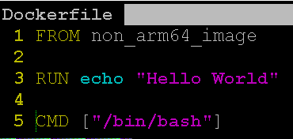
Base Image Example
We clone a repo that contains a Dockerfile, and a tar of an image called non_arm64_image.
The base image (non_arm64_image) appears to be for a platform that is not Arm.
We load (docker load) the non_arm64_image into the host and decide to build the Dockerfile anyway.
What happens if we try to build it on an Arm platform?

Slide 31
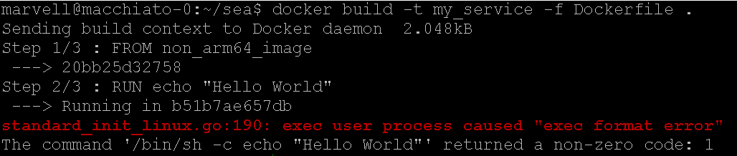
Base Image Example
Dockerfile build command
Build failed with “exec format error”
This usually means we’re running a binary from a different architecture.

Slide 32
Base Image Example
First thing to investigate is always the base image.

Slide 33
Base Image Example
Run the base image by itself, and see what happens.
In this case, we can’t even run bash, clearly something isn’t right with the base image.

Slide 34
Base Image Example
We don’t get an error when we try an Ubuntu image from DockerHub
Let’s update the Dockerfile with this image to see what happens.

Slide 35
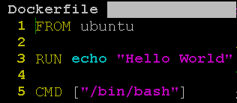
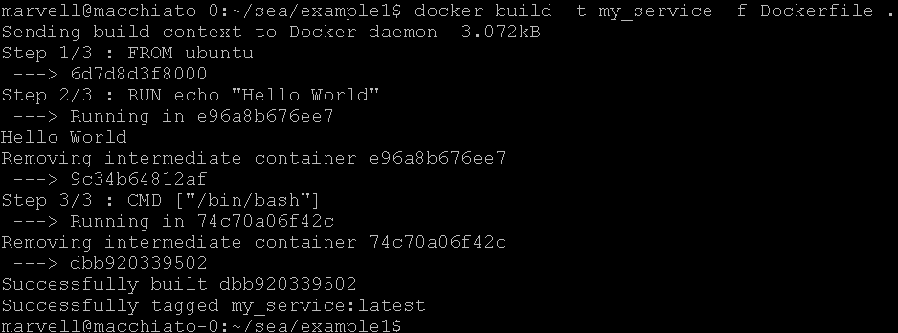
Base Image Example
After changing the base image, the Dockerfile builds successfully.

Slide 36
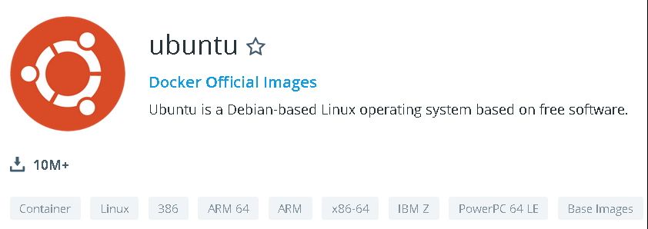

Base Image Example
This Dockerfile will build on the following architectures:
Arm (32/64 bit), x86(32/64 bit), PPC.
This is possible because the Ubuntu image on DockerHub is architecture agnostic.
Most popular images on DockerHub will run on Arm.
https://hub.docker.com/_/ubuntu

Slide 37
Base Image Takeaways
Check The Base Image:
Make sure the base image architecture matches your build machine architecture.
After all, we cannot cross build (or cross run) container images.
Suggestion:
Run the base image by itself before attempting to build an image with it.
If the base image is from Dockerhub, check it’s information page.
Example: Ubuntu Image on Dockerhub:
https://hub.docker.com/_/ubuntu
The good news:
Most standard/popular images on Dockerhub support many different architectures.

Slide 38
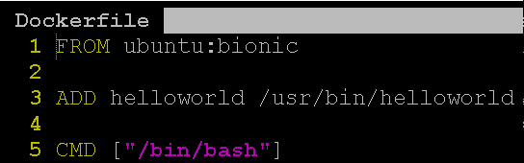
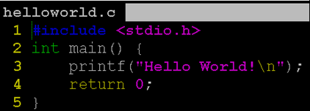
Application Binary Example
We clone a repo which contains a Dockerfile, a binary (helloworld), and a file helloworld.c.
It’s not clear which architecture the binary is compiled for.
We could check it with the ‘file’ program, but let’s not bother to do that here.
Dockerfile:
We know the base image supports Arm because we looked it up on DockerHub.
The Dockerfile copies the binary into the container image (line 3).

Slide 39
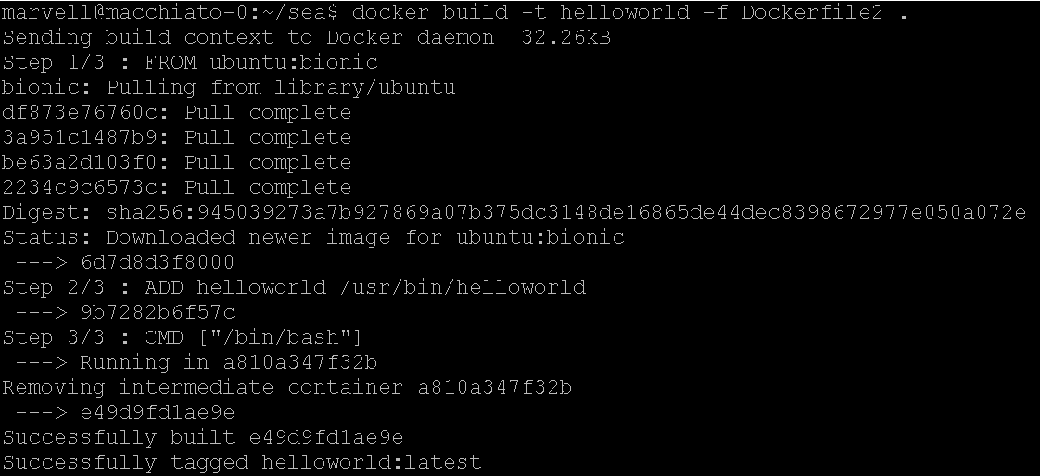
Application Binary Example
The Image builds successfully, but does that mean everything is ok?

Slide 40
Application Binary Example
Clearly something is wrong with the binary.

Slide 41
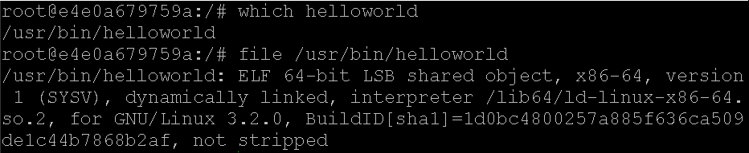
Application Binary Example
Clearly something is wrong with the binary.
Binary is not aarch64

Slide 42
Application Binary Example
The prebuilt binary is for x86.
Since we have the source code for the helloworld app, we should compile an Arm and x86 version of the app. Then we can select the binary when we build the container image.
In our case, we’ll build helloworld-arm64 & helloworld-x86.
On an Arm platform, or by cross compiling :
gcc helloworld.c -o helloworld-arm64
On x86 platform:
gcc helloworld.c -o helloworld-x86
Next, rewrite the Dockerfile so that the binary can be selected.

Slide 43
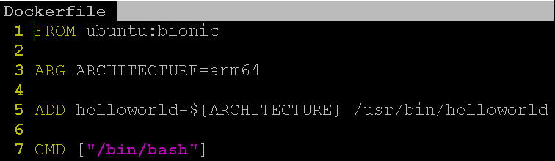
Application Binary Example
Add a Dockerfile argument called ARCHITECTURE (line 3).
This is the key feature of Dockerfiles that allows us to select the binary.
https://docs.docker.com/engine/reference/builder/#arg
The argument is referenced in the ADD command (line 5).
Notice the ARCHITECTURE argument is referenced here.
The default value of the argument is arm64.
This default value can be changed at build time.
Build and run.

Slide 44
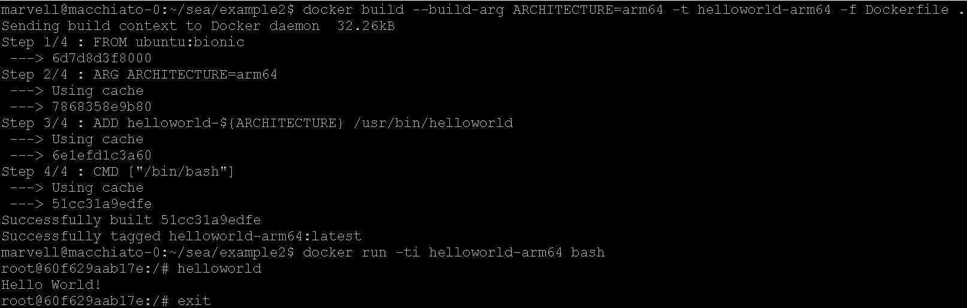
Application Binary Example
Set the Dockerfile argument in the build command.
Hello World!

Slide 45
Application Binary Example
Issues with this approach.
Requires binaries to be pushed to the code repo.
Although this works, it’s not the best solution because binaries will increase the size of the code repo.
A Git repo will keep all versions of the binary in its history.
Git was not designed to store binaries.
In the long run, this approach is unsustainable.
A better approach would be to use Make to build the binaries on the host before building the container image.
This would eliminate the need to push binaries into the Git repo.
An even better approach:
Eliminate the need for Make by building the binaries in the Dockerfile. Let’s try this next.

Slide 46
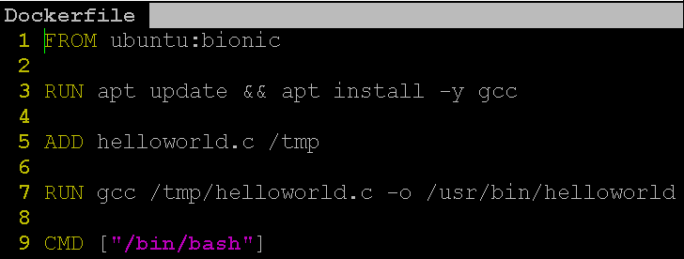
Application Binary Example
This improved Dockerfile will build the application and place it into /usr/bin (line 7).
Notice that the Dockerfile argument isn’t needed anymore.
There is no need to select an architecture since the binary is built in the container.
Can we do better than this? Yes!
This Dockerfile presents some issues:
Package installs (line 3).
Copying in of source code (line 5).
The above makes the container bigger, and could introduce security vulnerabilities.
This Dockerfile can be improved by using Docker’s multi-stage build feature.

Slide 47
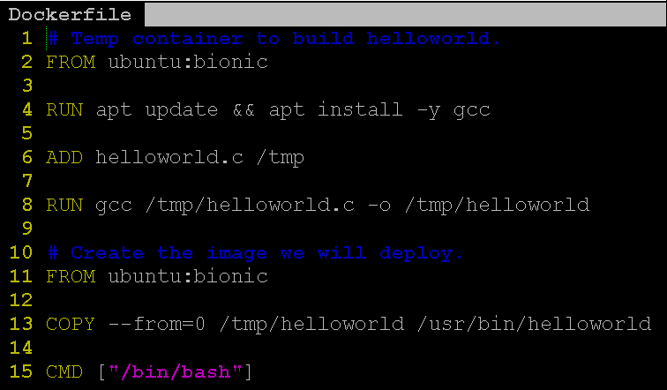
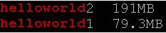
Application Binary Example
This Dockerfile will create a temporary container that builds helloworld (lines 1 - 8).
helloworld is then copied into the final container image (lines 11 -15).
Overall, we get an architecture agnostic container image that is also smaller.
Image size improvement

Slide 48
Application Binary Takeaways
Avoid using prebuilt binaries that are stored in your repo.
This is bad practice in any code project, not just container projects.
Build the binaries at container image build time.
Use Make to build binaries and container images (ok).
Build the binaries within the Dockerfile (better).
Use Docker’s multi-stage build feature (Recommended).
Another option; avoid building binaries:
Download binaries from a release server.
Install applications from a package repo.

Slide 49
Outline
General Education.
Application Stack.
Workload Isolation.
Virtual Machines vs. Containers.
Docker Basics.
Docker Best Practices For Multi-Arch.
Motivation.
Examples.
Multi-Arch Registries.

Slide 50
Registries
In the following slides we’ll lightly touch “multi-arch” registries.
For a deeper dive into the subject with examples, see the following blog post:
https://community.arm.com/tools/b/blog/posts/deploying-multi-architecture-docker-registry
A registry is a server that hosts prebuilt Docker images.
DockerHub
Docker Store
Users can also host a private registry.
Useful for having complete control over the distribution and use of your images.
Private registries are typically run from a container.
https://hub.docker.com/_/registry
https://docs.docker.com/registry/
Pulling from different registries.
The docker pull command is how we indicate which registry to pull from.
‘docker pull <registry_dns_name_or_ip>:<port>/<image_name>:<tag>’
If the registry DNS name or IP address is not included, it’s assumed the image will be pulled from DockerHub.
This is why the command ‘docker pull ubuntu:bionic’ pull from DockerHub.

Slide 51
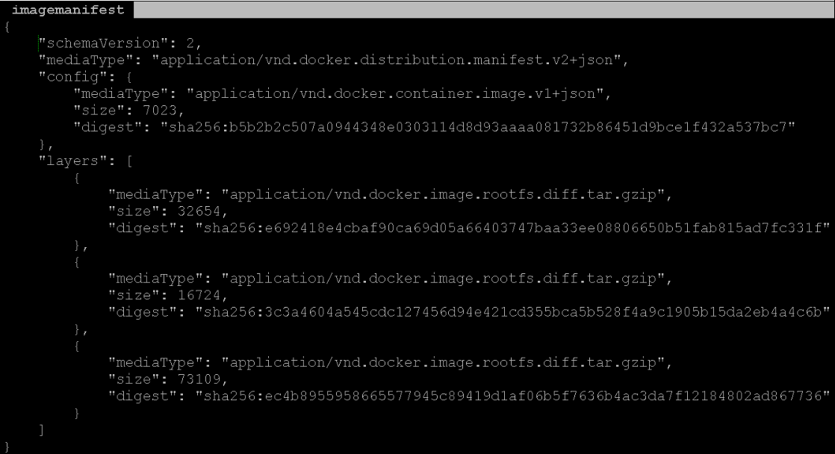
Registries
Image Manifests.
When an image is pushed into a registry, an Image Manifest is created.
The image manifest lists (among other things) all of the layers that make up the image.

Slide 52
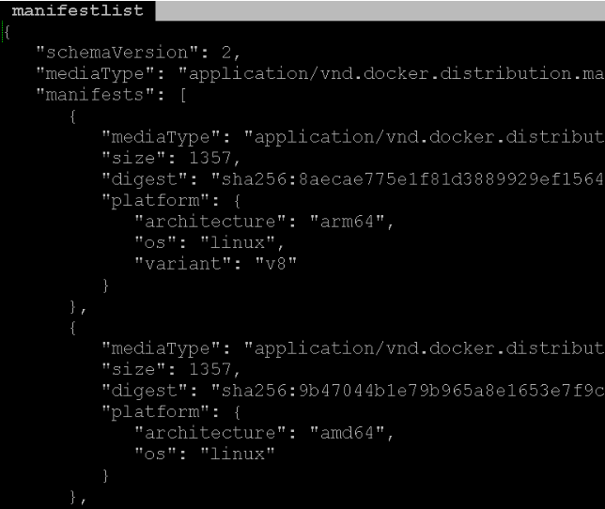
Registries
Manifest List
A Manifest List is a file that contains a list of Image Manifests.
An architecture will also be associated with each Image Manifest listed in the Manifest List
A manifest list is associated with each Image name/tag.
A manifest list is created with the docker manifest command.
https://docs.docker.com/engine/reference/commandline/manifest/
When a Docker host requests an image from the registry. The registry will provide a version of the image that is compatible with the requesting machine’s architecture.

Slide 53
Questions

